Slide 1
___?? … :P
[ TECHSPARDHA 2014 ]
DEVELOPED BY:
Aditya Vats
Shivam Jindal
Yashvinder Singh

Slide 2
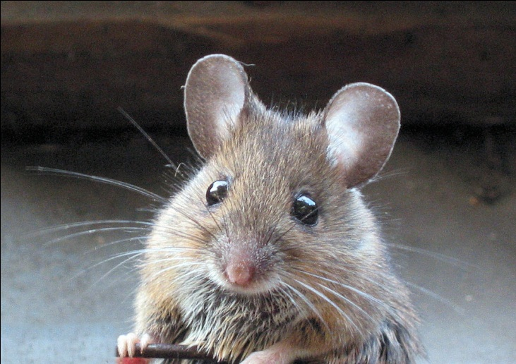
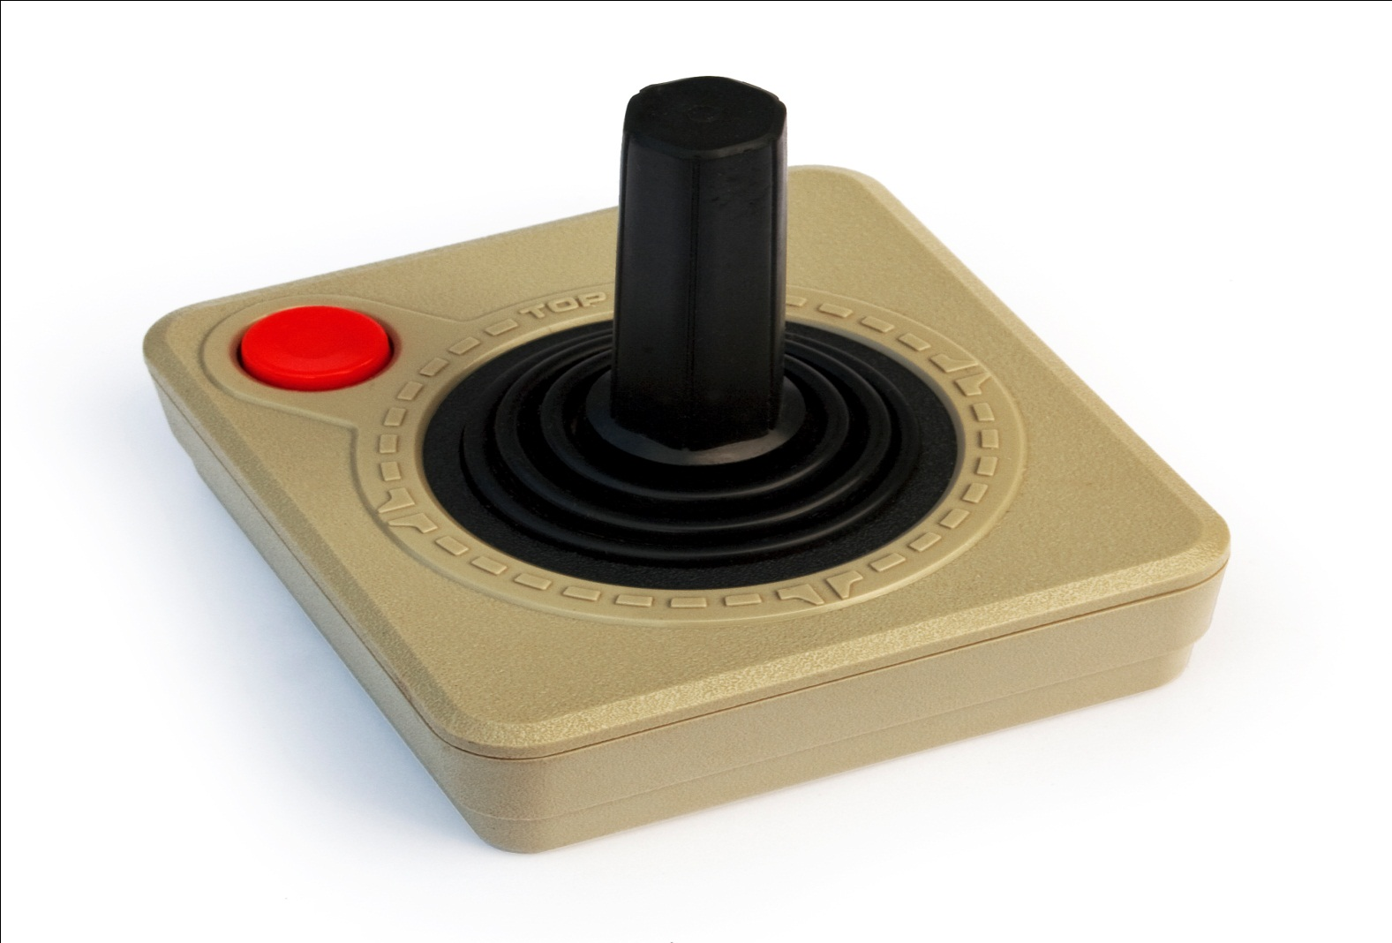

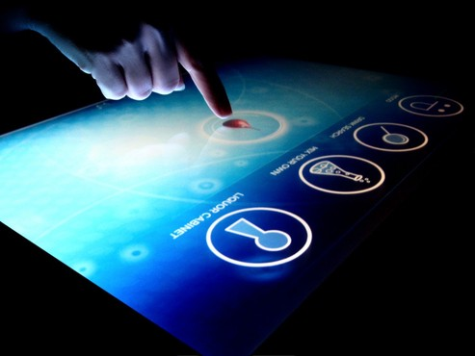
How many inputs methods can you think of ?

Slide 3
But Wait… There’s one more !

Slide 4
Gestures … !
Simply… a motion that’s intelligent enough to convey a message.

Slide 5
Presenting You…
JAI
(Just Another Input)

Slide 6
What Inspires Us ?
Earlier : “Need” was the mother of “Invention”.
But now…
“LAZINESS” has replaced the “Need”.

Slide 7
What Inspires Us ?
Limited and “Not so cool” methods of input !
The fact that everyone’s Laptop has a camera.
The fact that everyone has the legal right to simplicity !

Slide 8
What we actually developed ?
A windows based software that detects the user’s gesture through a webcam and maps the gestures onto the navigation keys .
A software that allows the user to control the cursor movement through gestures.

Slide 9
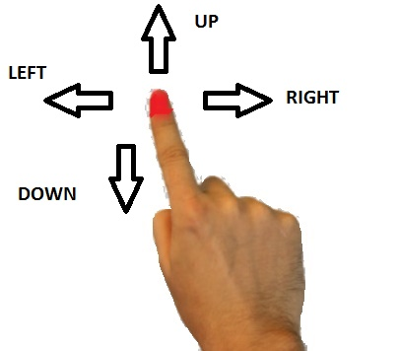
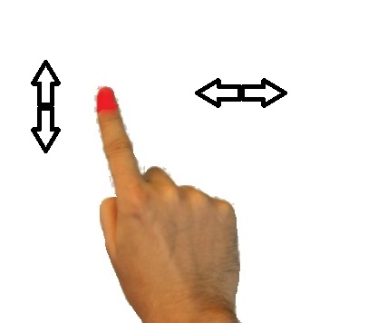
Gesture Controls Implemented
Controlling Navigation Keys
Controlling Mouse Keys

Slide 10
How did we do it ?
Used Image Processing for Object Detecting and Tracking.
The position of the tracked object is used to calculate the position of the cursor on screen.
The trajectory traced by the object gives the pattern that we are looking for.. !

Slide 11
Now…. What you can do ?
Throw your mouse away.. Let your fingers take control of your computer !
Experience motion sensor games on your computer.
Giving presentations will never be so easy…

Slide 12
Now … Down to Business
Can be adapted by the organizations working for the physically disabled .
Can be integrated with the OS as an additional input medium.
Possibility of being used in gaming consoles.

Slide 13
Scope for Improvement
Extending to detect multi-finger gestures.
Using gestures for drawing.
Typing using gestures.
Integrating more gestures.
Exporting to mobile platforms and tablets.
Adding extra capabilities to gaming consoles.

Slide 14
Thank You ! JAI HO!
Queries ?

